Slide 1

RCB
Winning Strategy
Bagging Game-Changers
in the IPL Auction
KIRAN KUMAR PRADHAN
MAY BATCH - 2025

Slide 2
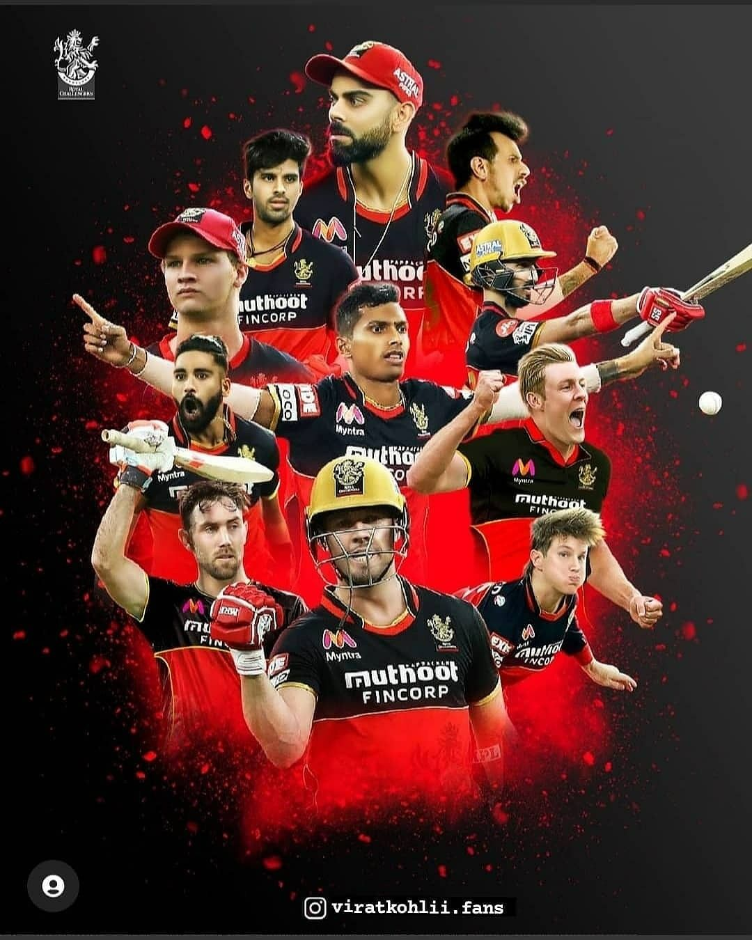
About RCB
•Royal Challengers Bangalore (RCB) was established in 2008 as one of the original eight franchises in the Indian Premier League (IPL), purchased for Rs 464 crore, making it one of the league’s most expensive teams at launch
•RCB was known for its star-studded line-ups but inconsistent results, finishing as IPL runners-up three times (2009, 2011, and 2016) and often missing the playoffs in other seasons despite its popularity and big-name acquisition.

Slide 3
Analysis objective
To develop an auction strategy to bag the best players for IPL Season 2017.
Suggesting the players who will be the best fit for the team and can help RCB win the championship trophy.
Analyzing the performances of present and past players of the RCB team and as well as other players, to find the most consistent players.
Analyzing the team’s weaknesses and strengths to finalize the players who can best fit into the team.
Formed an auction strategy for bagging the best players for the RCB team, who will help in winning the championship.

Slide 4
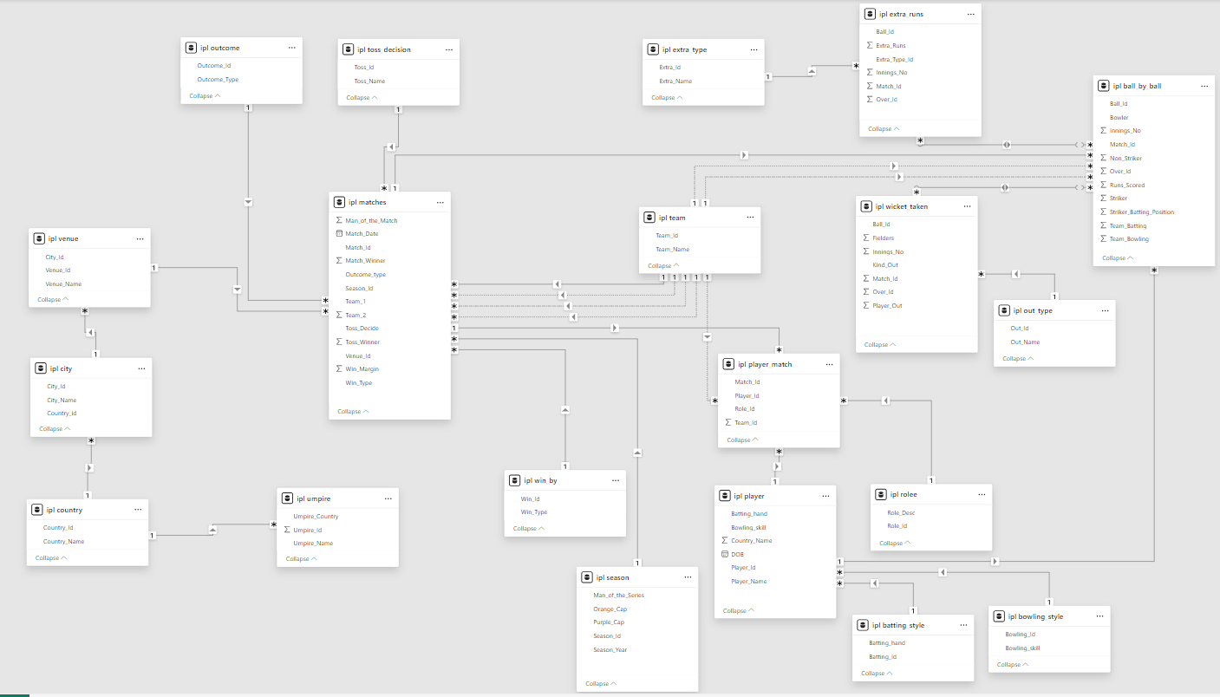
DATABASE SCHEMA

Slide 5
IPL DATASET OVERVIEW
Ball by Ball
Match_id: Unique identifier for a cricket match
Over_id: Unique identifier for an over in a cricket match
Ball_id: Unique identifier for a ball in an over
Innings_No: The innings number in a cricket match
Team_Batting: The team batting in a particular innings
Team_Bowling: The team bowling in a particular innings
Striker_Batting_Position: The batting position of the striker batsman
Striker: The batsman currently on strike
Non_Striker: The batsman currently at the non-striker's end
Bowler: The bowler bowling the current delivery
Batting style
Batting_id: Unique identifier for a batsman's batting record
Batting_hand: The batting hand (right or left) of a batsman
Bowling style
Bowling_id: Unique identifier for a bowler's bowling record
Bowling_skill: The bowling skill (e.g., right-arm fast, left-arm spin) of a bowler
City
City_id: Unique identifier for a city
City_Name: The name of a city
Country_id: Unique identifier for a country

Slide 6
Matches
Match_Id: Unique identifier for each match.
Match_Date: The date when the match took place.
Match_Winner: The team that won the match.
Outcome_Type: Type of result (win, tie, etc.).
Toss_Winner: The team that won the toss.
Win_Type: The method by which the match was won (e.g., runs or wickets).
Win_Margin: The margin by which the match was won.
Venue_Id: Reference to the venue where the match was played.
Season_Id: The season in which the match occurred.
Venue
Venue_Id: Unique identifier for each venue.
Venue_Name: Name of the venue.
City_Id: Reference to the city where the venue is located.
Country
Country_Id: Unique identifier for each country.
Country_Name: Name of the country.
Player Match
Match_Id: Reference to the match in which the player participated.
Player_Id: Reference to the player.
Role_Id: Role of the player (e.g., batsman, bowler).
Team_Id: Team that the player represented in the match.
Wickets Taken
Ball_Id: Reference to the specific ball during which the wicket was taken.
Fielder: Reference to the player who fielded the ball.
Bowler: Reference to the bowler who took the wicket.
Player_Out: Reference to the player who was dismissed.

Slide 7
Extra Type
Extra_Type_Id: Unique identifier for the type of extra runs scored in a cricket match.
Extra_Runs: The number of extra runs scored in a particular delivery.
Innings_No: The innings number in a cricket match.
Extra_Id: Unique identifier for an instance of extra runs scored.
Extra_Name: The name or description of the type of extra runs scored (e.g., byes, leg byes, wides, no-balls).
Season
Season_Id: Unique identifier for a particular season or tournament.
Venue_Id: Unique identifier for the venue or stadium where the match is played..
Win_By
Win_Type: The type of win (e.g., runs, wickets) achieved by the winning team.
Win_Margin: The margin of victory (e.g., runs or wickets) for the winning team.
Outcome
Outcome_type: The type of outcome or result of the match (e.g., win, loss, tie, no result).
Match_Winner: The team that won the match.
Man_of_the_Match: The player awarded the Man of the Match award.
Out_Type
Out_Id: Unique identifier for the type of dismissal or way a batsman got out.
Out_Name: The name or description of the type of dismissal (e.g., caught, bowled, lbw, run out).
Outcome_Id: Unique identifier for the outcome or result of a match.

Slide 8
Rolee
Role_Id: Unique identifier for a player's role or skills (e.g., batsman, bowler, all-rounder).
Role_Desc: Description of a player's role or skills.
Man_of_the_Series: The player awarded the Man of the Series award for a particular tournament.
Orange_cap: The player awarded the Orange Cap (for most runs scored) in a particular tournament.
Purple_cap: The player awarded the Purple Cap (for most wickets taken) in a particular tournament.
Team
Team_Id: Unique identifier for a team.
Team_Name: The name of a team.
Umpire
Umpire_id: Unique identifier for an umpire officiating the match.
Umpire_name: The name of an umpire.
Umpire_country: The country or nationality of an umpire.
Toss Decision
Toss_Name: The name or description of the toss (e.g., heads or tails).
Player
Player_Id: Unique identifier for a player.
Player_Name: The name of a player.

Slide 9

Extra Runs
Ball_Id: Reference to the specific ball during which extra runs were conceded.
Extra_Type_Id: Type of extra run (e.g., wide, no-ball).
Innings_No: The innings number during which the extra run occurred.
Match_Id: Reference to the match in which the extra runs were conceded.

Slide 10

Methodology
Data Cleaning: Thoroughly checked the entire dataset for any inaccuracies, but the data is clean.
Data Aggregation: Used various aggregation functions such as count(), sum(), avg(), etc., to aggregate the data and get a meaningful summary.
Data Manipulation: Created a view named “all_data” by using joins, and also used sub-queries for easier analysis.
Data Measurement: Measured the data of various players by using aggregation functions and other functions like limit, window rank functions, etc.
Data Visualization: Used Excel for visualization of outputs to summarize the data, gain meaningful insights, and identify any trends.

Slide 11
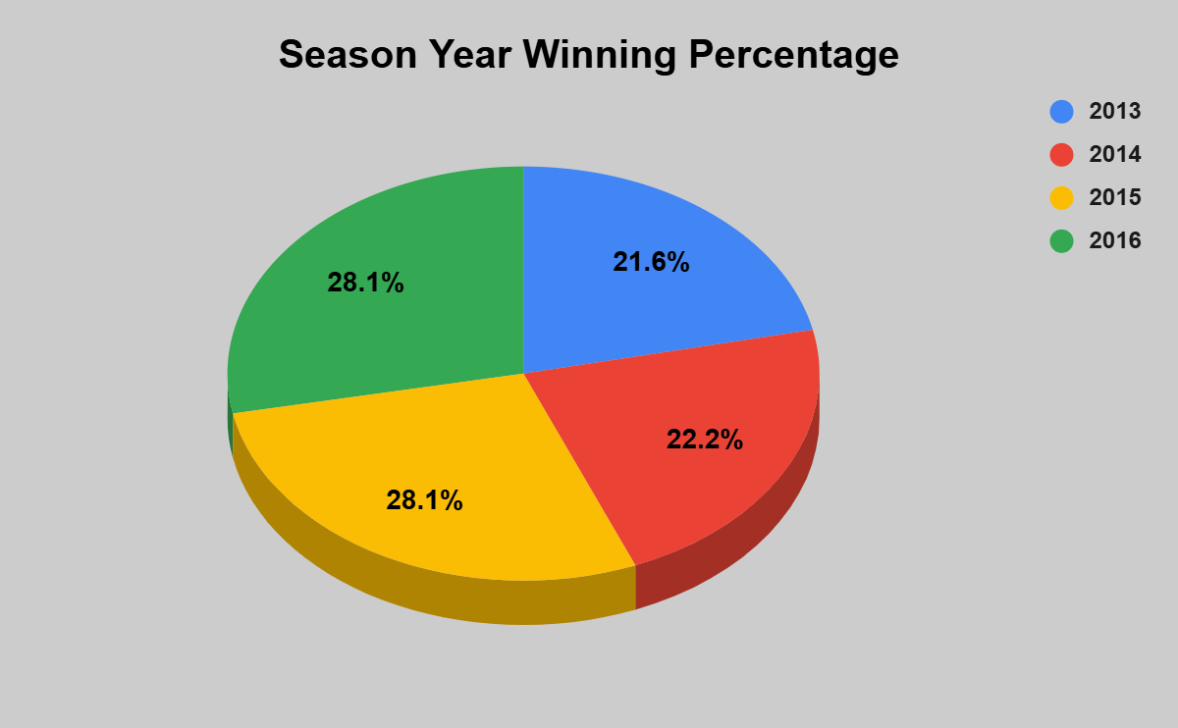
RCB’s past seasons performance analysis.
From 2008 to 2016, RCB didn’t win a single championship.
Here, the pie chart shows the winning percentage of RCB in the past 4 seasons.
In the past 4 seasons, RCB has not even won 60% of the matches played.

Slide 12
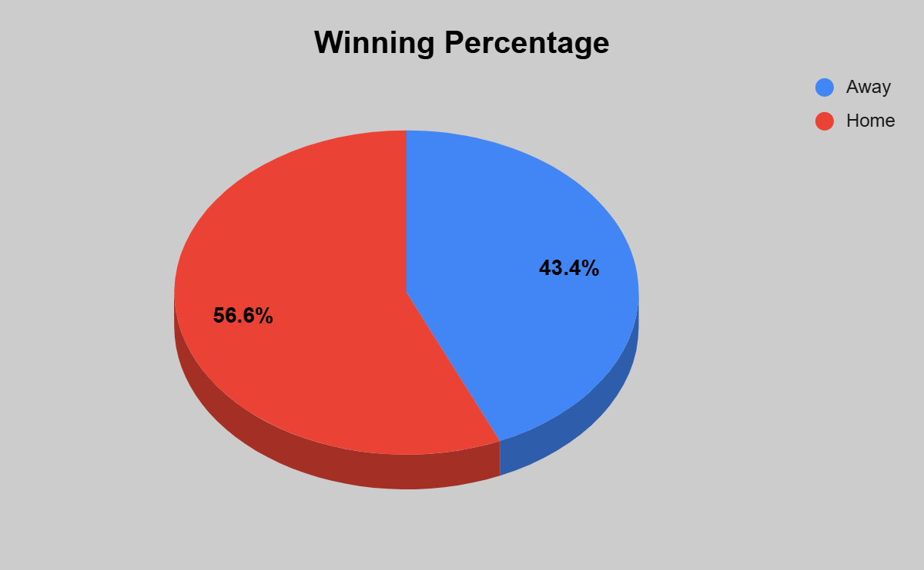
RCB’s winning percentages of Home and Away..
RCB has a higher winning percentage at home-ground with 57%, which shows that RCB is utilizing the home-ground advantage properly.

Slide 13
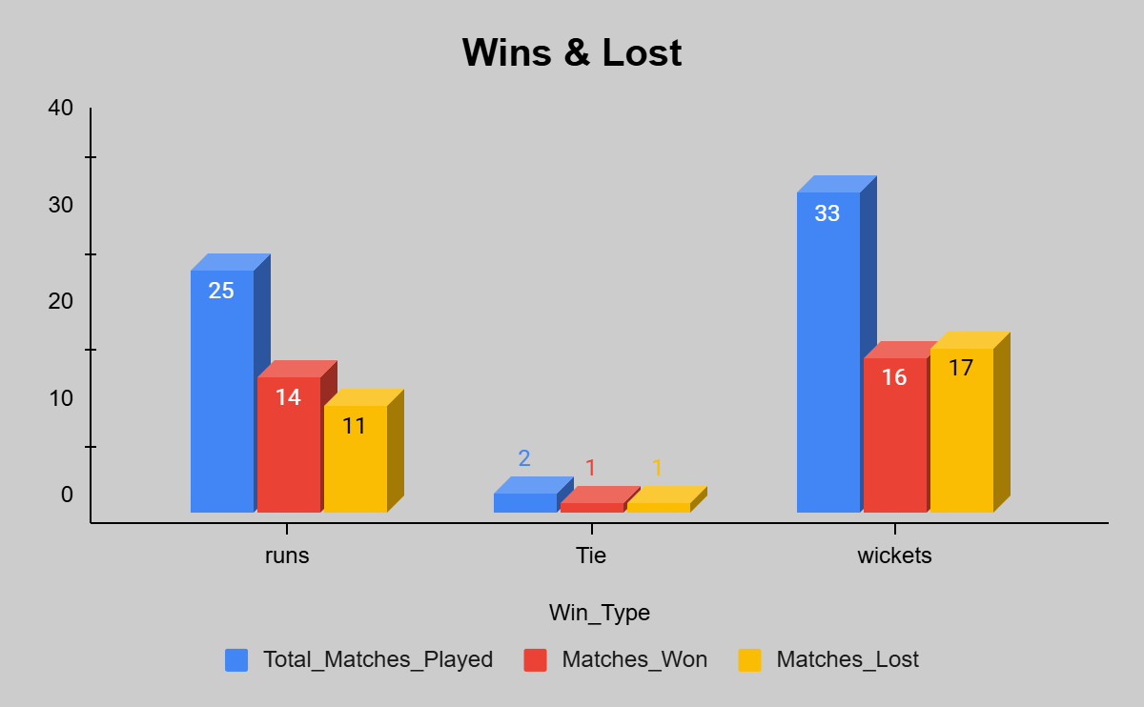
Matches won or lost by runs, wickets, and ties
In the past 4 seasons, RCB has batted first in 25 matches, in which RCB won 14 matches and lost 11 matches.
RCB bowled first in 33 matches, in that it won only 16 matches and losing 17 matches.

Slide 14
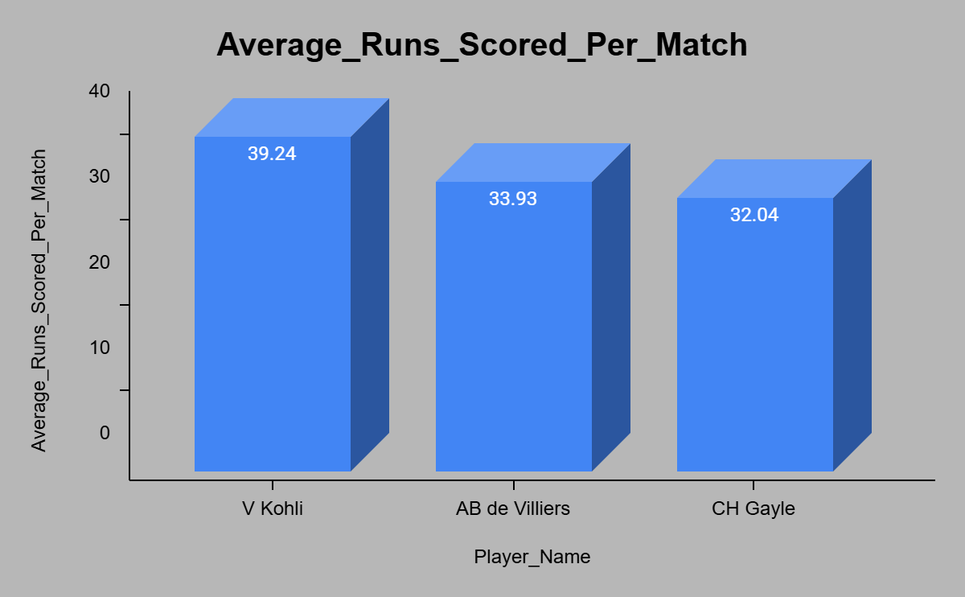
Potential reasons for RCB
not winning trophy
From the past 4 seasons, there are only 3 batsmen who have an average runs scored per match greater than 30.
INSIGHTS
The team need two or three batsmen to score more runs while setting targets and chasing.

Slide 15
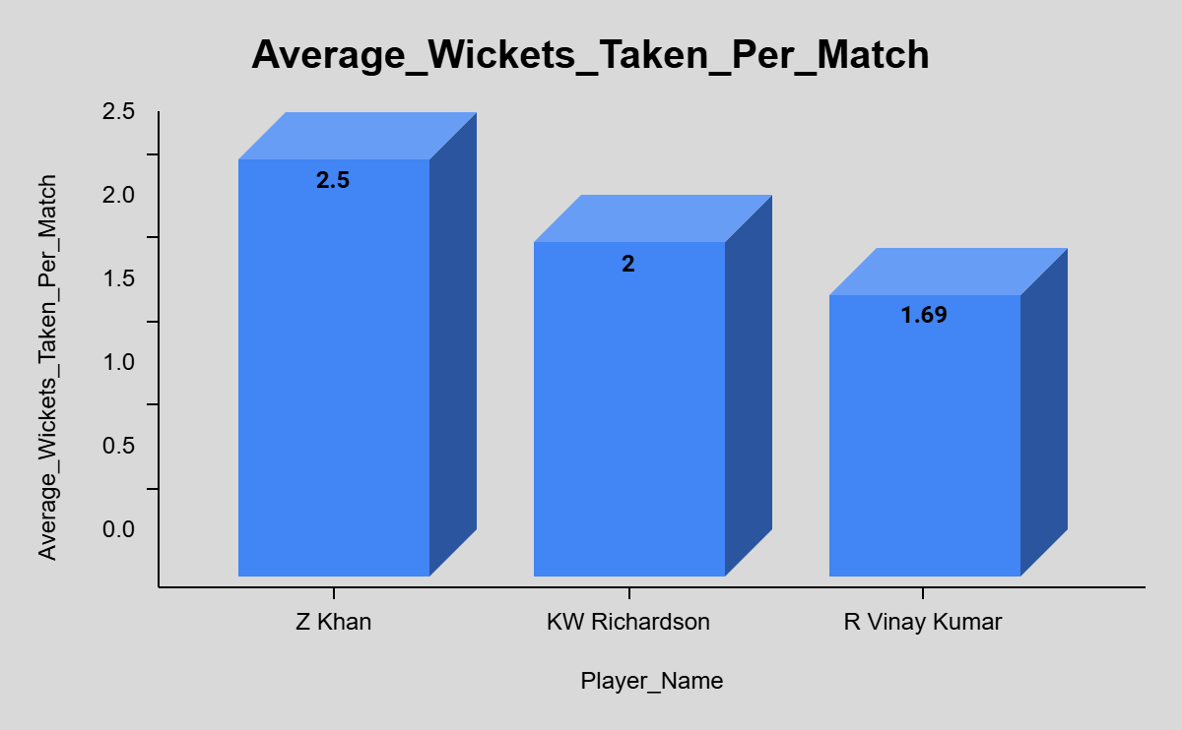
Top Bowlers In Past 4 Seasons..
From the past 4 seasons, there are only 3 bowlers who have an average of wickets taken per match greater than 3.
INSIGHTS
The team needs to get two or three bowlers to take more wickets or to prevent opponents from scoring.

Slide 16
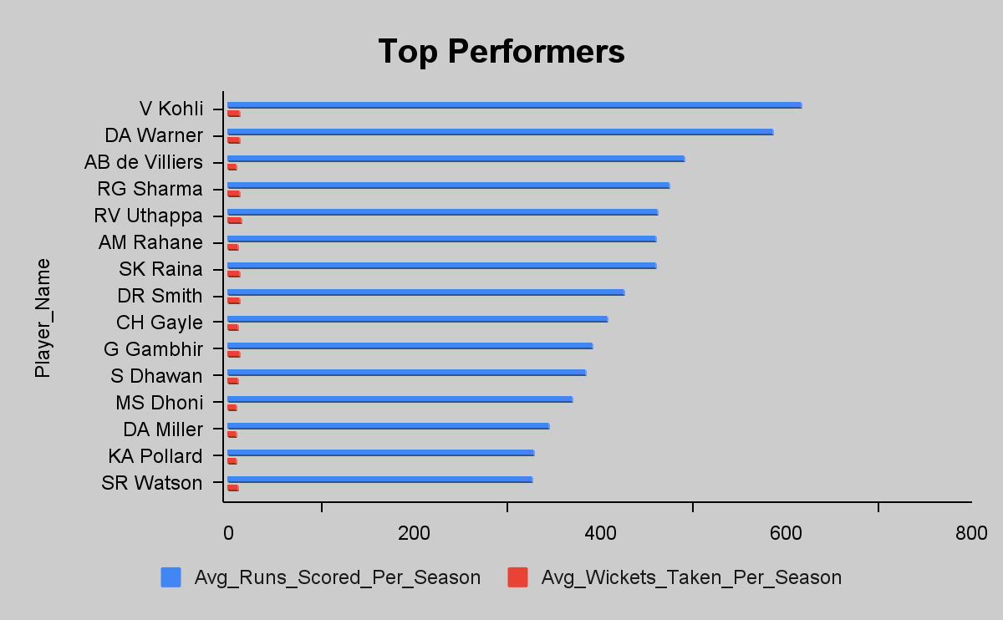
Top 15 players' performances both in scoring runs and wickets taken

Slide 17
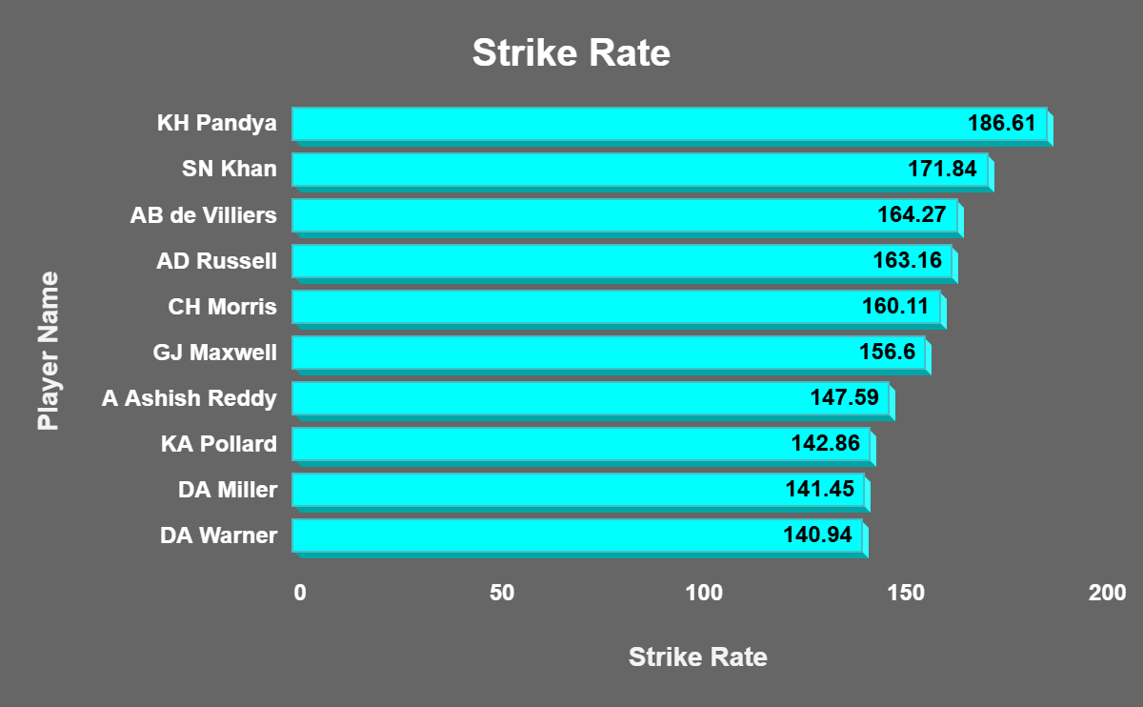
Top batsmen from the past 4 seasons..
These are the top 10 batsmen who have a strike rate greater than 140.
KH Pandya stands at the top with a strike rate of 186.61, followed by SN Khan with a strike rate of 171.84

Slide 18
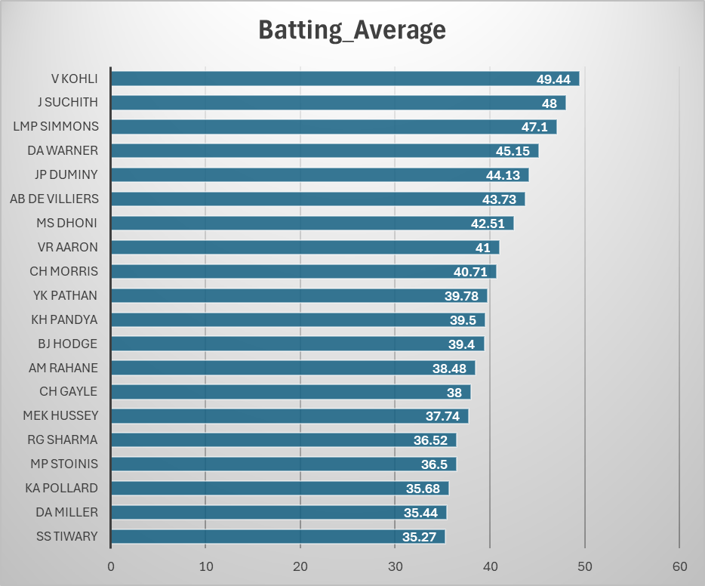
Top 20 batsmen with
batting average > overall average..
These players contributed more runs to their team in peak times and became a reason for their team's success.
Virat Kohli stands in the top position with a 49.44 batting average, followed by J Suchith with a batting average of 48.

Slide 19
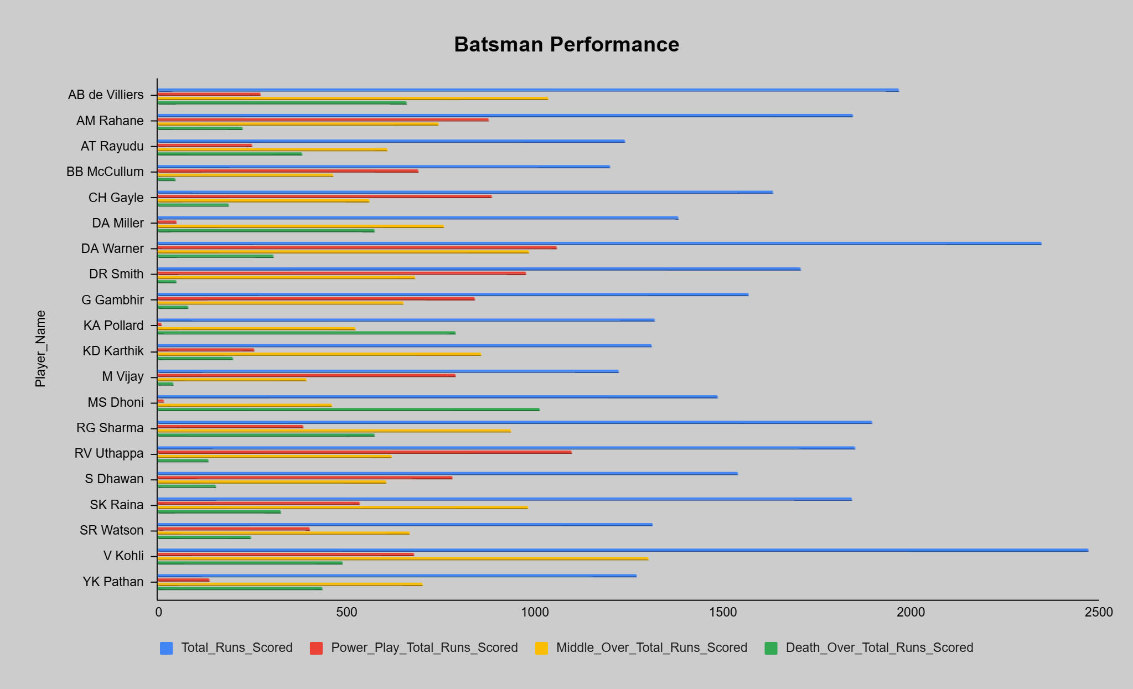
Top Batsmens Based on Overs..
The chart displays the top 20 batsmen's situational performances
Situational performances are more useful in improving teams' strategies.

Slide 20
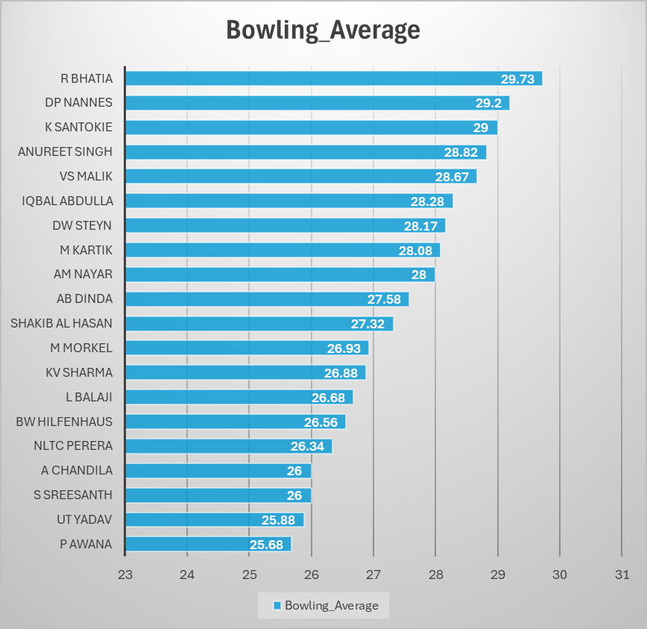
Top 20 bowlers with
bowling average > overall average..
These players contributed more wickets to their team in peak times and became a reason for their team's success.
R Bhatia stands in the top position with a 29.73 bowling average, followed by DP Nannes with a bowling average of 29.2

Slide 21
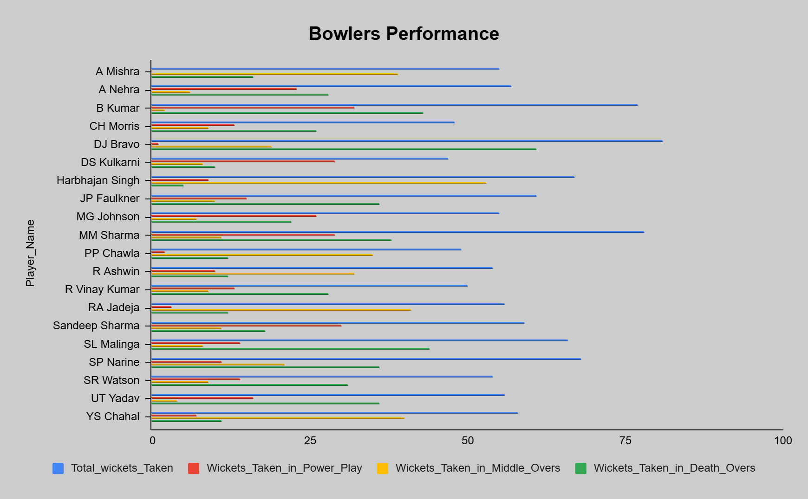
Top Batsmens Based on Overs..
Top 20 bowlers' situational performances according to the total wickets taken by them in the past 4 seasons
Situational performances are more useful in improving team strategies.

Slide 22
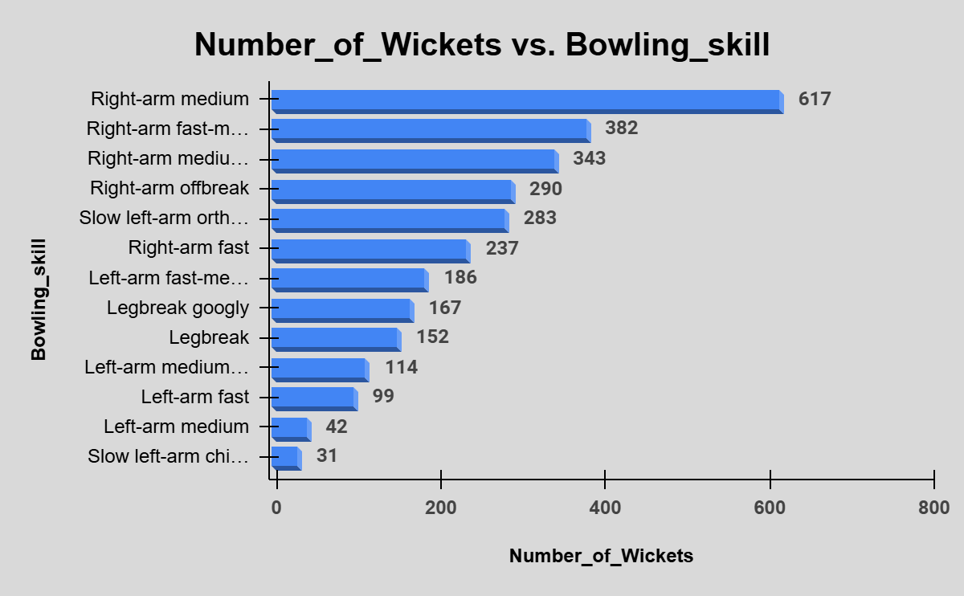
Impact of bowling on taking wickets..
The highest number of wickets is taken by the bowlers who have right-arm medium style, with a total wickets taken count as 617.
And the second highest, 382 wickets, are taken by bowlers who have right-arm fast-medium style.

Slide 23
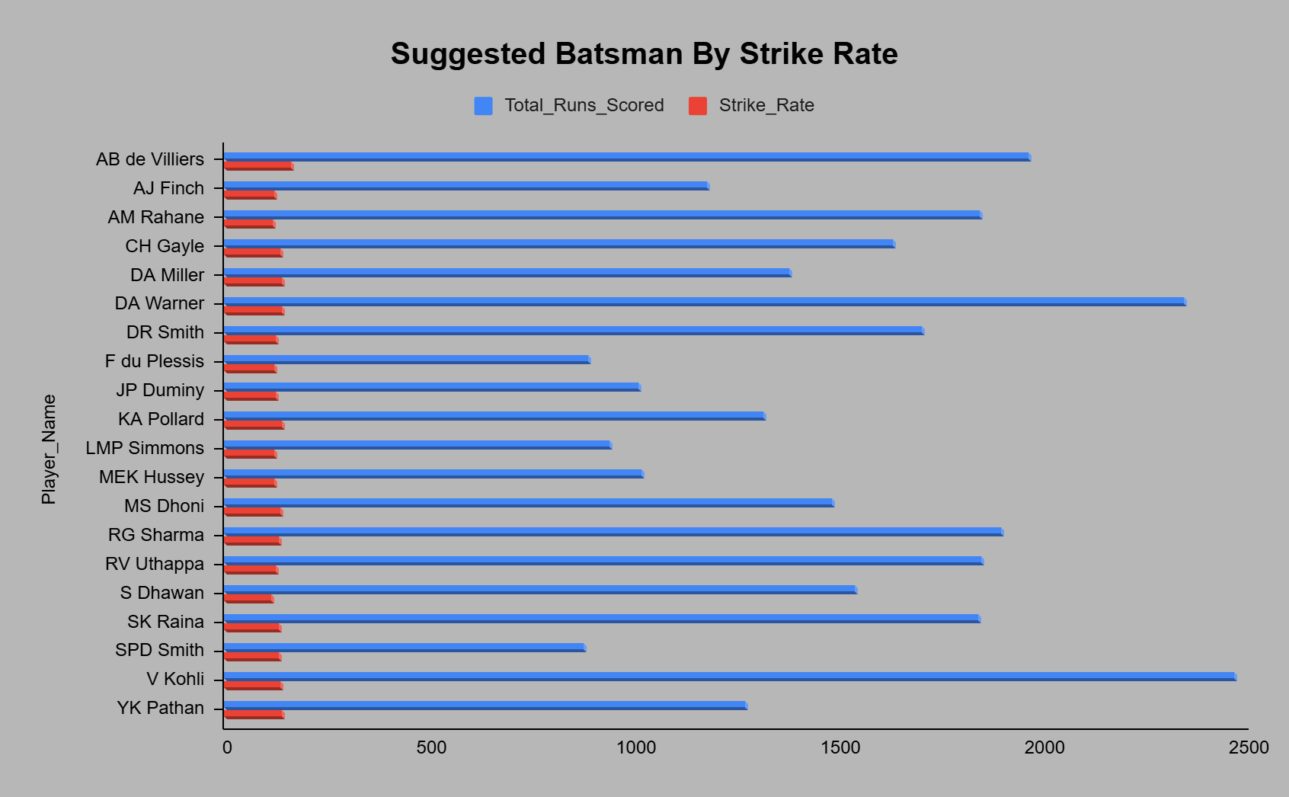
Batsmen suggested to the team..
These are the best 20 batsmen I would suggest to the team.
Virat Kohli, AB de Villiers, and CH Gayle are the top performers of RCB in past seasons, so they should continue with them in this season also.
Apart from them, it's best to bag at least two other players, which makes the team more strong and helps in winning the trophy.

Slide 24
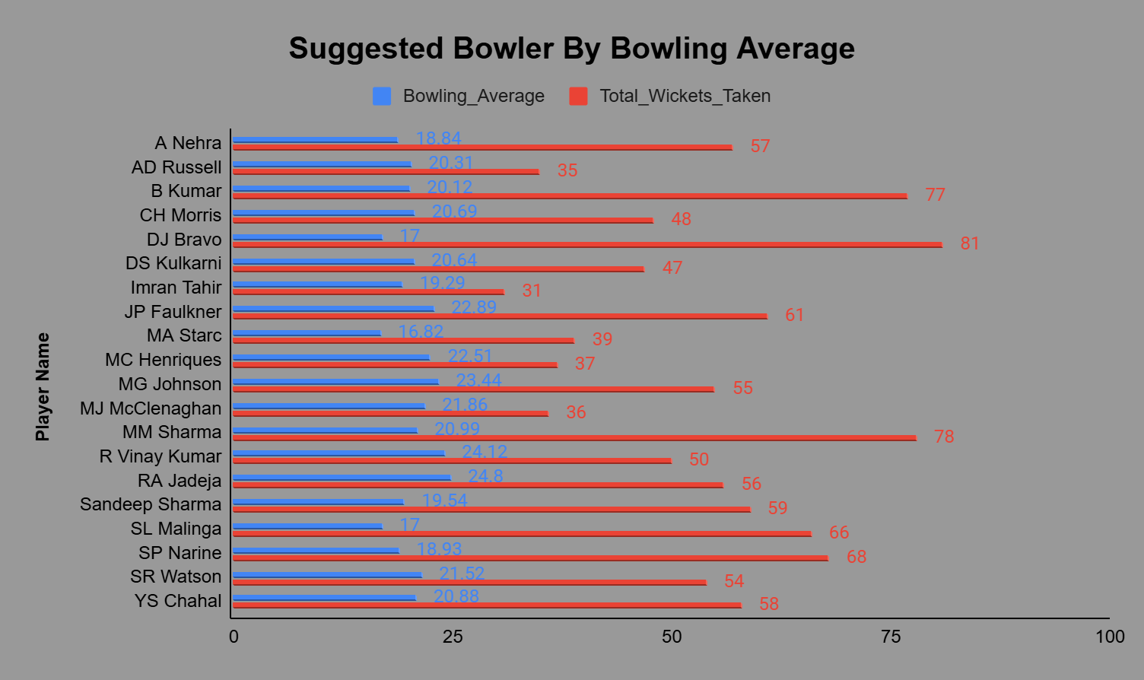
Bowlers suggested to the team..
These are the best 20 bowlers I would suggest to the team.
DJ Bravo stands in the top position by taking 81 wickets in the past 4 seasons and having a bowling average of 17.
All the other players should also be considered because all of them have a bowling average of less than 25.

Slide 25
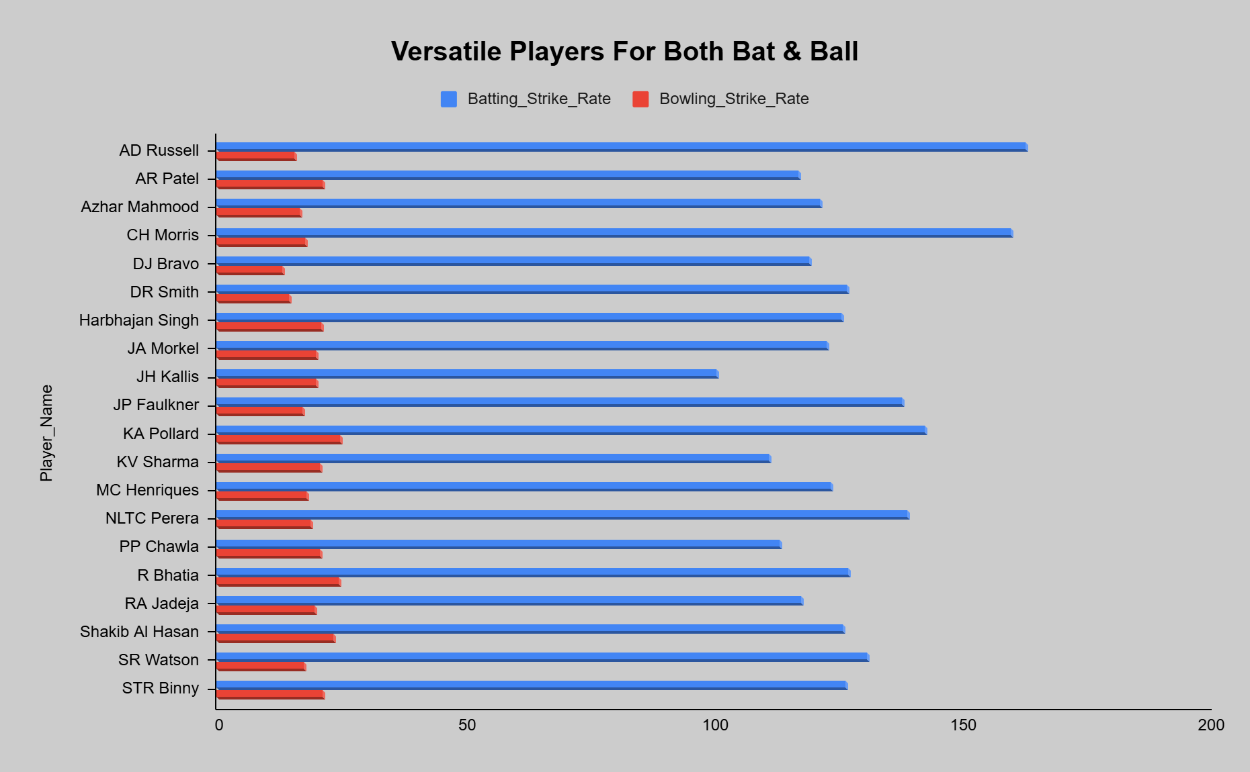
All-rounders suggested to the team..
All-rounders are the players who can pull the team in both batting and bowling or fielding.
The chart displays the top 20 all-rounders based on their bowling and batting strike rates.

Slide 26
Conclusion..
In conclusion, RCB needs to improve its win percentage to be a strong team in the IPL.
Having an explosive batsman who can give a flying start in the powerplay phase can help boost the team's total and ease pressure on other batsmen.
Good economic bowlers can help in defending low totals and also restrict opposition batsmen from putting a high total.
Also, RCB needs to capitalize on home-ground advantage more than they do currently.
They should focus on getting bowlers who could take advantage of conditions at home more often.
Getting high-performing all-rounders is also recommended and can be the difference between winning and losing the match.

Slide 27

KIRAN KUMAR PRADHAN..

